Slide 1


Slide 2

Major Project-II (01CE0807)
Review 2 (03/01/2026)
Data-Driven Portfolio Optimization using LSTM-GRU Forecasting and Deep Q-Learning
Team ID: 8PRO_184
Team Member 1: Raj Mungara (92200103223)
Team Member 2: Darshan Vasoya (92200103199)
Team Member 3: Rupesh Rudakiya (92200103222)
Guided By
Internal Guide Name: Rahul Jain
Department of Computer Engineering, Faculty of Engineering & Technology

Slide 3
Outline
Abstract
Introduction
Literature Review
Tools & Technology
Methodology
Result
Conclusion

Slide 4
Abstract
This project proposes a hybrid deep learning and reinforcement learning framework for intelligent portfolio optimization in dynamic financial markets. The LSTM–GRU hybrid model is employed for accurate forecasting of stock price movements and volatility patterns by learning temporal dependencies from historical financial data. The predicted insights are then utilized by a Deep Q-Learning (DQL) agent to optimize asset allocation strategies in a simulated trading environment. The agent continuously learns reward-maximizing policies by balancing expected returns with risk exposure, leading to adaptive and data-driven portfolio management. This synergistic integration of sequential modeling and reinforcement-based decision optimization enables robust, self-learning financial systems capable of outperforming static investment strategies in uncertain market conditions.

Slide 5
Introduction
In today’s world, the stock market changes very quickly and is hard to predict.
Traditional investment methods do not adapt well to these market changes.
Our project focuses on creating a smart, data-driven system that can make better investment decisions automatically.
We use LSTM and GRU models to study past stock data and predict future prices and trends.
Then, a Deep Q-Learning agent uses these predictions to decide how much to invest in each stock.
The system keeps learning from past results, improving its decisions over time.
This helps investors get higher returns with lower risk compared to fixed or manual strategies.
In short, our project combines deep learning and reinforcement learning to build an intelligent portfolio optimization model.

Slide 6
Literature Review
Author | YEAR | Dataset | Title | Accuracy | Strenghts | Limitation | Model Used
Yashaswi Kumar | 2021 | U.S. Stock Market (S&P 500) | Deep Reinforcement Learning for Portfolio Optimization using Latent Feature State Space Module | Sharpe = 1.42 | Uses latent feature extraction before DRL; improves stability | Limited asset diversity | DQN (Deep Q-Learning)
Jaydip Sen et al. | 2021 | NSE & NASDAQ | Stock Portfolio Optimization Using a Deep Learning LSTM Model | MAE 0.021 | Accurate stock price prediction using LSTM | Does not include RL optimization | LSTM
Jungyu Ahn et al. | 2022 | Korean Stock Market | Reinforcement Learning Portfolio Manager Framework with Monte Carlo Simulation | ROI +8.5% vs baseline | Introduces Monte Carlo data augmentation | High computational cost | Actor-Critic RL
Hui Niu et al. | 2022 | U.S. Equities (Yahoo Finance) | MetaTrader: A Reinforcement Learning Approach Integrating Diverse Policies for Portfolio Optimization | Sharpe = 1.65 | Combines multiple expert RL policies adaptively | Requires heavy tuning | PPO + Meta-Policy Network
Ruyu Yan et al. | 2024 | Chinese A-share stocks | Reinforcement Learning for Deep Portfolio Optimization | Sharpe = 1.58 | Combines deep learning + RL with risk cost reward | High sensitivity to hyperparameters | DDPG + CNN feature extractor

Slide 7
Literature Review
Author | YEAR | Dataset | Title | Accuracy | Strenghts | Limitation | Model Used
Joy Dip Das et al. | 2024 | S&P 500 + Crypto | Hybrid Data-Driven and Deep Learning Based Portfolio Optimization | RMSE = 0.019 | BiLSTM + BiGRU hybrid improves forecasting | No RL decision layer | BiLSTM + BiGRU
Garrido-MerchÃ¡n et al. | 2023 | ESG Stock Index | Deep Reinforcement Learning for ESG Financial Portfolio Management | Sharpe = 1.33 | Integrates ESG scoring + DRL optimization | Limited data scope | A2C (Advantage Actor Critic)
Jaydip Sen et al. | 2023 | Indian Stock Market | Comparative Analysis of Portfolio Optimization Using Mean-Variance, HRP, and RL Approaches | ROI = 12% vs baseline | Comparative evaluation of classical vs RL methods | No hybrid forecasting | DQN based RL
Arishi Orra et al. | 2025 | DOW 30 Stocks | Deep Reinforcement Learning for Investor-Specific Portfolio Optimization: A Volatility-Guided Approach | Sortino = 1.28 | Combines volatility forecasting + DRL policy | Lacks interpretability | DRL (PPO + Volatility Model)
Springer Authors | 2025 | Global Market Indices | Risk-Adjusted Deep Reinforcement Learning for Portfolio Optimization | Sharpe = 1.72 | Risk-aware reward design + multi-agent ensemble | Complex training pipeline | PPO + CNN ensemble
H Yang et al. | 2022 | U.S. Stock Market | LSTM-Based Deep Model for Investment Portfolio | Higher Return / Risk Ratio vs baseline | Combines LSTM + Genetic Algorithm for portfolio weighting | Does not include RL module | LSTM + Genetic Algorithm

Slide 8
Literature Review
Author | YEAR | Dataset | Title | Accuracy | Strenghts | Limitation | Model Used
Z Song et al. | 2023 | U.S. Equities | An Interpretable Stochastic Model-Free Reinforcement Learning Framework for Portfolio Optimization | Outperforms benchmarks on risk-adjusted returns | Risk-aware interpretable RL with stochastic policy gradient | Focuses only on equity data; complex reward tuning | Stochastic RL (Gaussian policy + critic)
Chuting Sun et al. | 2023 | Multivariate Stock Returns | Dynamic CVaR Portfolio Construction with Attention-Powered Generative Factor Learning | Improved CVaR and tail-risk metrics | Uses Attention-GRU and factor learning for robust returns | Not pure RL approach; complex to train | Attention-GRU + CVaR optimization
H Zouaoui & M-N Naas | 2025 | 25 Cryptocurrencies (2021â€“2024) | Portfolio Optimization Based on MPT-LSTM Neural Networks | Sharpe = 1.53 (vs 0.79 baseline) | LSTM-based weight prediction improves crypto risk-return | Limited to crypto assets only; lacks RL layer | LSTM (MPT-based weight predictor)
W Zhang et al. | 2025 | High Dimensional Assets (Global Markets) | Enhancing Portfolio Optimization via Heuristic-Guided Deep RL & Graph Neural Networks | Improved dynamic adaptability; ROI +11% vs baseline | Combines GNN structure learning with RL for allocation | High complexity; limited interpretability | Deep RL + Graph Neural Network
X Wang & L Liu | 2025 | Commodity Futures Markets | Risk-Sensitive Deep Reinforcement Learning for Portfolio Optimization | Sharpe = 4.34; Sortino = 57.77 | Strong risk-adjusted results; transformer-based agent | Tested mainly on commodities; may overfit specific assets | ART-DRL (Transformer + Multi-agent RL)

Slide 9
Tools & Technology
Programming Language: Python
Deep Learning Frameworks: TensorFlow / Keras / PyTorch
Data Handling & Analysis: Pandas, NumPy, Scikit-learn
Visualization Tools: Matplotlib, Seaborn
Financial Data APIs: Yahoo Finance

Slide 10
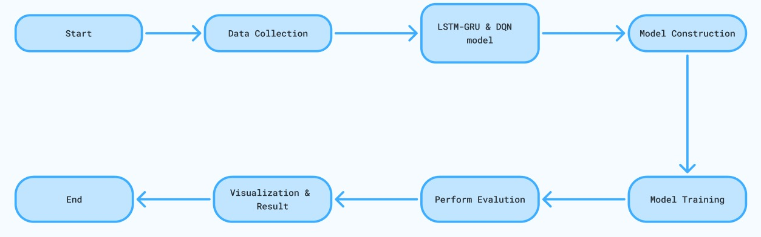
Methodology

Slide 11
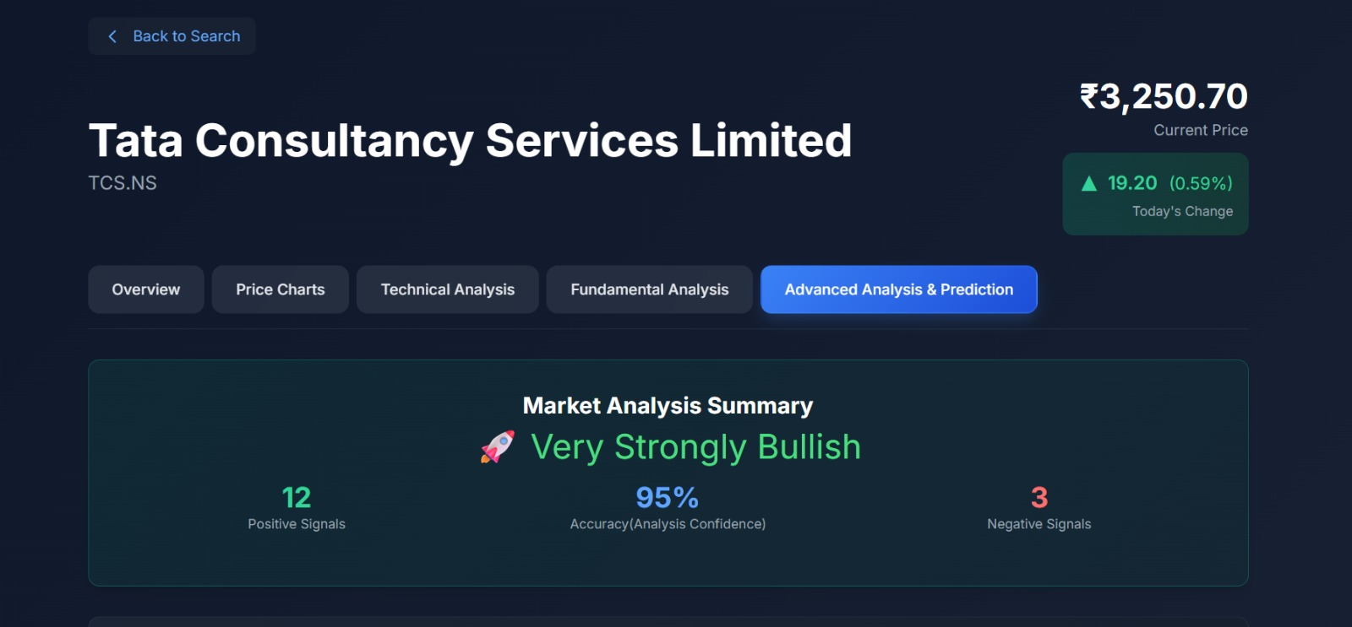
Result

Slide 12
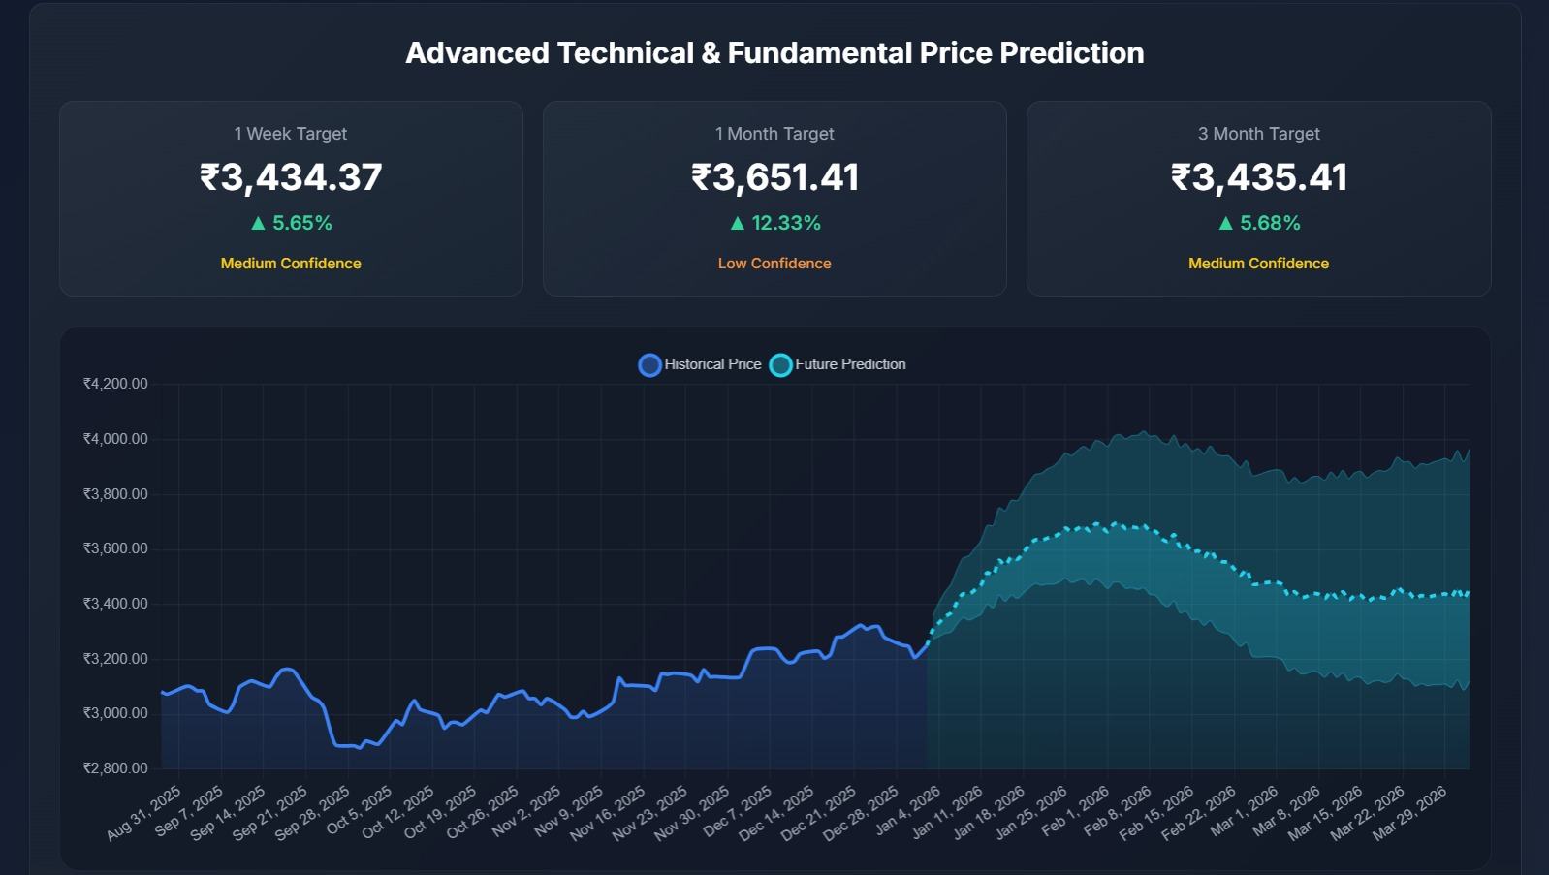
Result

Slide 13
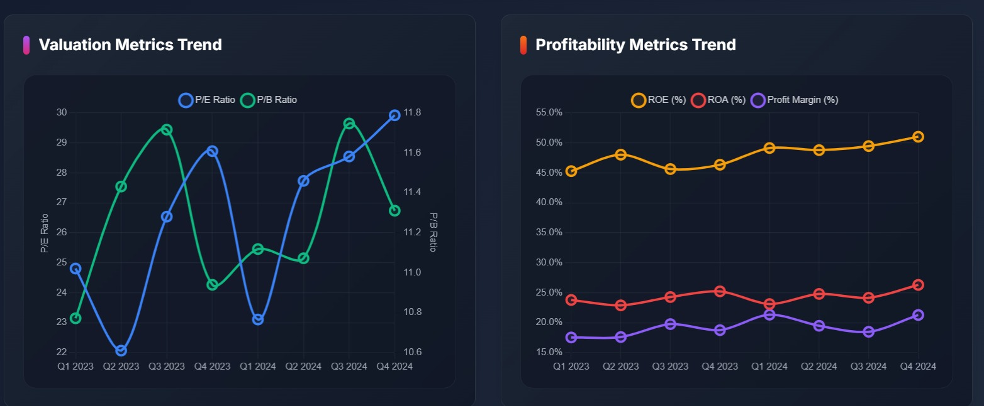
Result

Slide 14
Conclusion
Conclusion:-
The Data-Driven Portfolio Optimization using LSTM-GRU Forecasting and Deep Q-Learning project was successfully completed. The hybrid LSTM-GRU model accurately forecasted asset prices, which were effectively used by the Deep Q-Learning agent for dynamic portfolio allocation. The results demonstrate improved portfolio performance and adaptability compared to traditional optimization methods. This approach highlights the potential of combining deep learning and reinforcement learning in financial decision-making.

Slide 15
References
[1] Y. Kumar, “Deep Reinforcement Learning for Portfolio Optimization using Latent Feature State Space Module,” arXiv preprint arXiv:2102.06233, 2021.: https://arxiv.org/abs/2102.06233
[2] J. Sen, A. Dutta and S. Mehtab, “Stock Portfolio Optimization Using a Deep Learning LSTM Model,” International Journal of Computer Applications, vol. 183, no. 2, pp. 1–8, 2021. : https://www.semanticscholar.org/paper/Stock-Portfolio-Optimization-Using-a-Deep-Learning-Sen-Dutta
[3] J. Ahn, S. Park, J. Kim and J.-H. Lee, “Reinforcement Learning Portfolio Manager Framework with Monte Carlo Simulation,” arXiv preprint arXiv:2207.02458, 2022. https://arxiv.org/abs/2207.02458
[4] H. Niu, S. Li and J. Li, “MetaTrader: A Reinforcement Learning Approach Integrating Diverse Policies for Portfolio Optimization,” arXiv preprint arXiv:2210.01774, 2022. https://arxiv.org/abs/2210.01774
[5] R. Yan, J. Jin and K. Han, “Reinforcement Learning for Deep Portfolio Optimization,” Electronic Research Archive, vol. 32, no. 9, pp. 5176–5200, 2024 https://doi.org/10.3934/era.2024239
[6] J. D. Das, S. Bowala, R. K. Thulasiram and A. Thavaneswaran, “Hybrid Data-Driven and Deep Learning-Based Portfolio Optimization,” Journal of Mathematical Finance, vol. 14, no. 3, pp. 271–310, 2024.: https://doi.org/10.4236/jmf.2024.143016

Slide 16
References
[7] G. Garrido-Merchán, J. Hernández-Lobato and A. Sánchez, “Deep Reinforcement Learning for ESG Financial Portfolio Management,” arXiv preprint arXiv:2307.09631, 2023. https://arxiv.org/abs/2307.09631
[8] A. Orra, A. Bhambu, H. Choudhary, M. Thakur and S. Natarajan, “Deep Reinforcement Learning for Investor-Specific Portfolio Optimization: A Volatility-Guided Asset Selection Approach,” arXiv preprint arXiv:2505.03760, 2025. https://arxiv.org/abs/2505.03760
[9] H. Zouaoui and M.-N. Naas, “Portfolio Optimization Based on MPT-LSTM Neural Networks,” Finance, Accounting and Business Analysis Journal, vol. 7, no. 1, pp. 45–62, 2025 https://faba.bg/index.php/faba/article/view/265
[10] H. Yang, X. Liu and J. Chen, “LSTM-Based Deep Model for Investment Portfolio,” IEEE Access, vol. 10, pp. 73215–73225, 2022. https://pmc.ncbi.nlm.nih.gov/articles/PMC9283061/
[11] Z. Song, H. Chen and F. Liu, “An Interpretable Stochastic Model-Free Reinforcement Learning Framework for Portfolio Optimization,” Applied Intelligence, vol. 53, pp. 10391–10407, 2023 https://link.springer.com/article/10.1007/s10489-022-04217-5

Slide 17
References
[12] C. Sun, Q. Wu and X. Yan, “Dynamic CVaR Portfolio Construction with Attention-Powered Generative Factor Learning,” arXiv preprint arXiv:2301.07318, 2023. https://arxiv.org/abs/2301.07318
[13] W. Zhang, L. Qian and P. Zhang, “Enhancing Portfolio Optimization via Heuristic-Guided Deep Reinforcement Learning and Graph Neural Networks,” Proceedings of the 33rd International Joint Conference on Artificial Intelligence (IJCAI), 2025. https://www.ijcai.org/proceedings/2025/1054.pdf
[14] X. Wang and L. Liu, “Risk-Sensitive Deep Reinforcement Learning for Portfolio Optimization,” Journal of Risk and Financial Management, vol. 18, no. 7, pp. 347–361, 2025. https://www.mdpi.com/1911-8074/18/7/347
[15] H. Zouaoui and M.-N. Naas, “Portfolio Optimization Based on MPT-LSTM Neural Networks,” Finance, Accounting and Business Analysis Journal, vol. 7, no. 1, pp. 45–62, 2025. https://faba.bg/index.php/faba/article/view/265
[16] Springer Authors, “Risk-Adjusted Deep Reinforcement Learning for Portfolio Optimization,” Springer Journal of Intelligent Systems, vol. 29, no. 2, pp. 1–15, 2025.
https://link.springer.com/article/10.1007/s44196-025-00875-8 \

Slide 18


